Slide 1
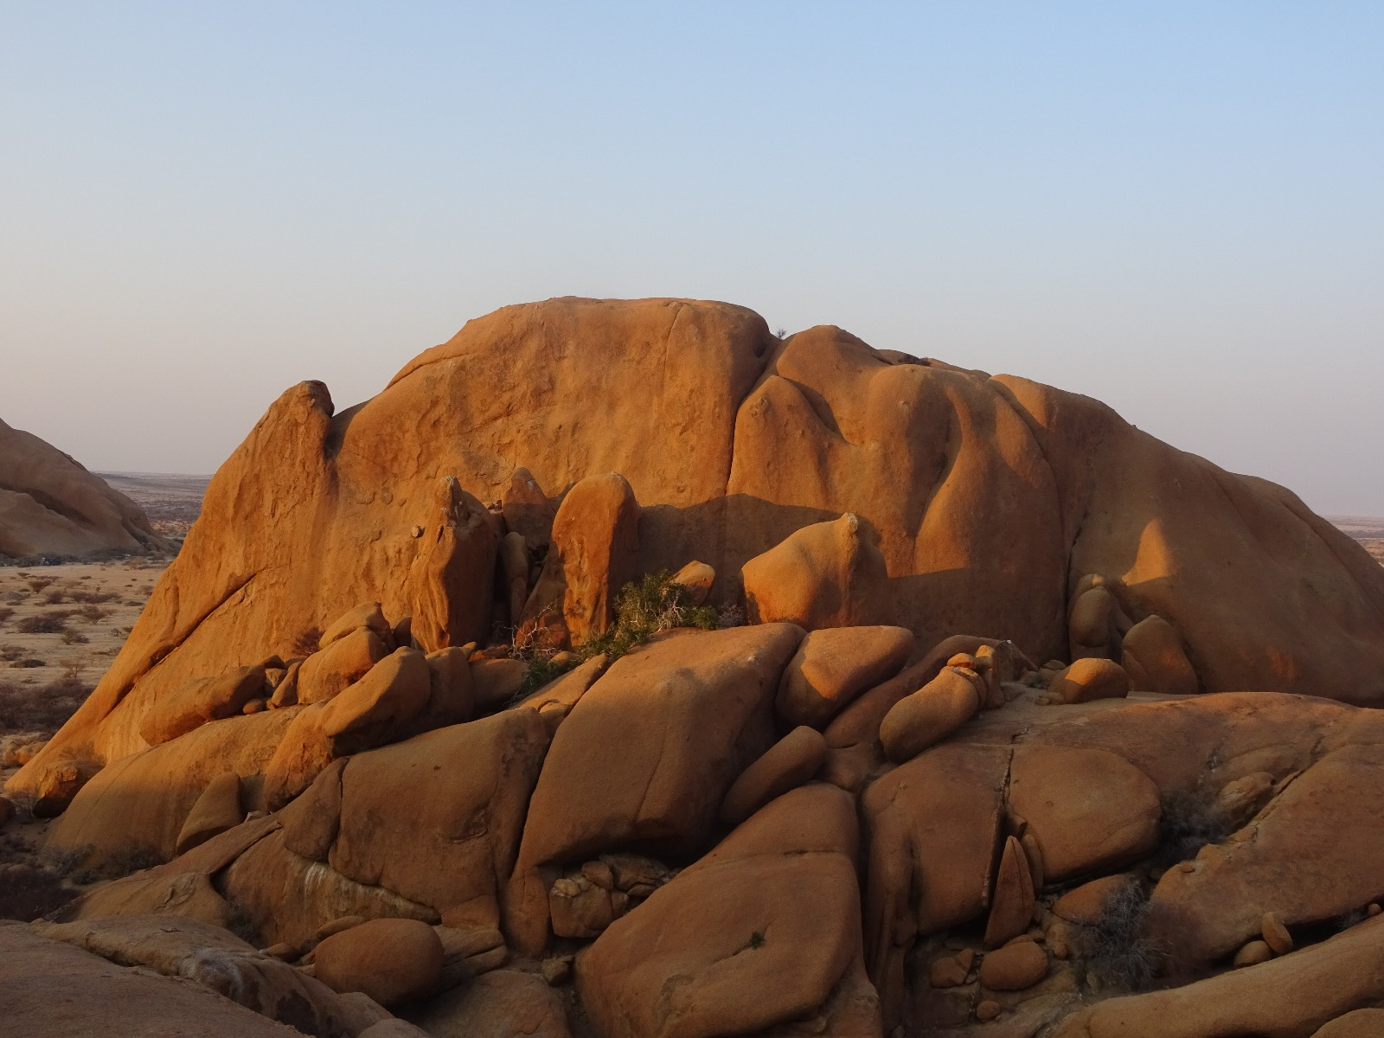
Lecture 4; Matrix models
Becoming a prophet
Age based matrix models
Stage based matrix models
Overview of R

Slide 2
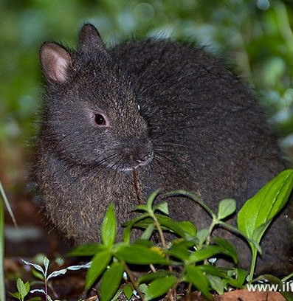
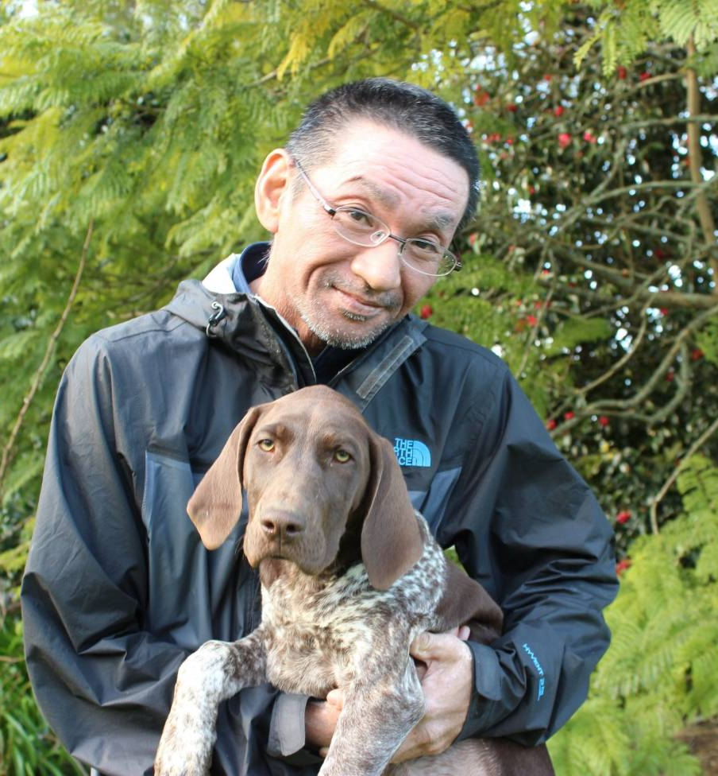
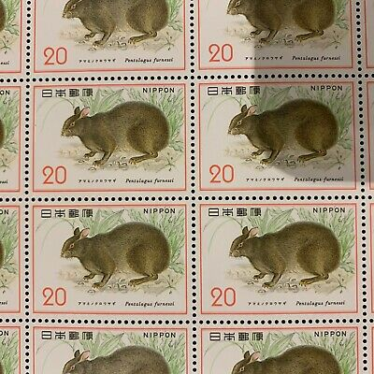
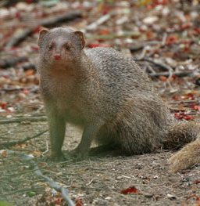
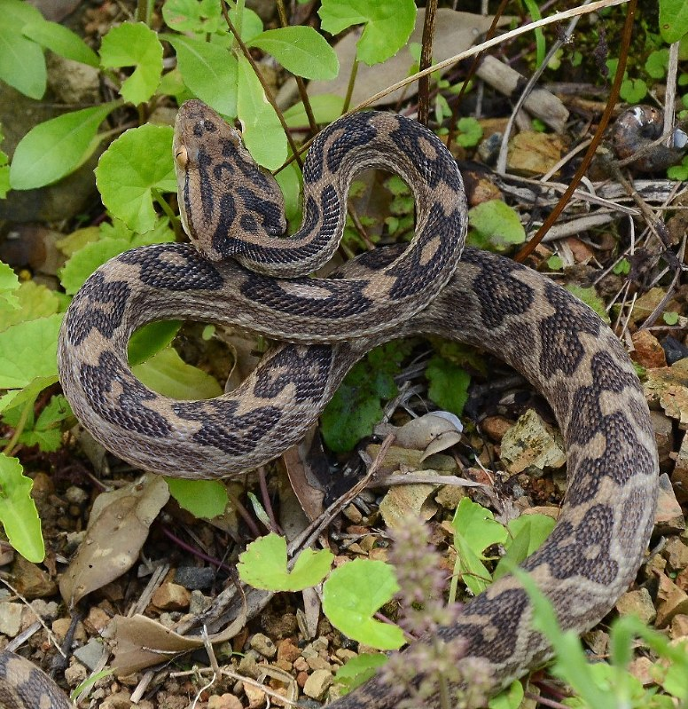



Slide 3
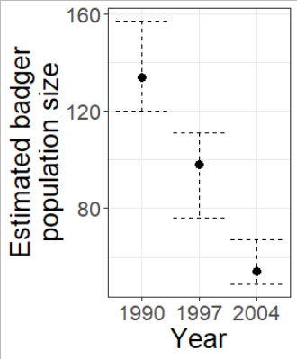
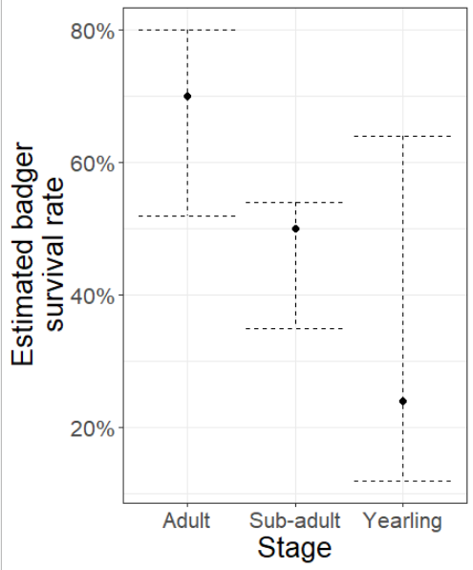
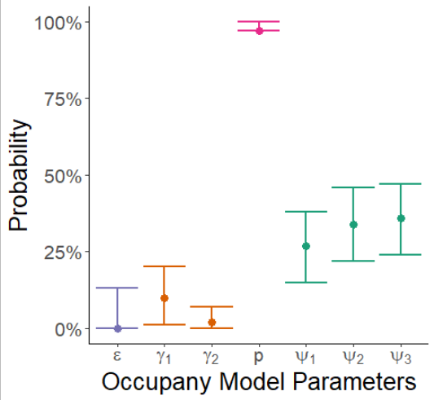
What we have so far:
Abundance estimates of an Amami rabbit population over 3 occassions
1965, 1982, 2015
Survival estimates of an Amami rabbits population
Survival recovered with control of mongoose, but still declining
Occupancy models of Java mongoose
Showing fewer sites are occupied by mongoose overtime, suggesting control is effective
Will Amami rabbits go extinct or take over the world?

Slide 4
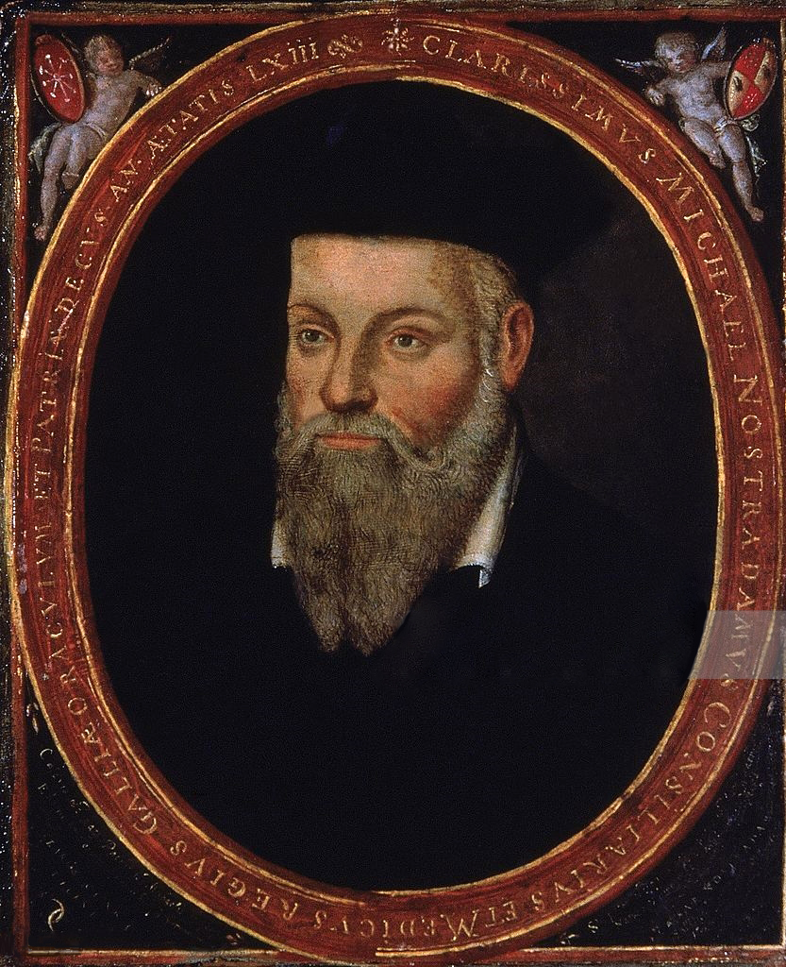
Les Prophéties
Michel de Nostredam
Dec 1503 – July 1566
Astrologer, physician and seer
Could peak into the future and make predictions of future events
Correctly predicted rise of Napoleon, Hitler, Hiroshima & Nagasaki bombings etc.
Except he didn’t, people just said he predicted those things or “postdictions”
(a posteriori hypotheses)

Slide 5

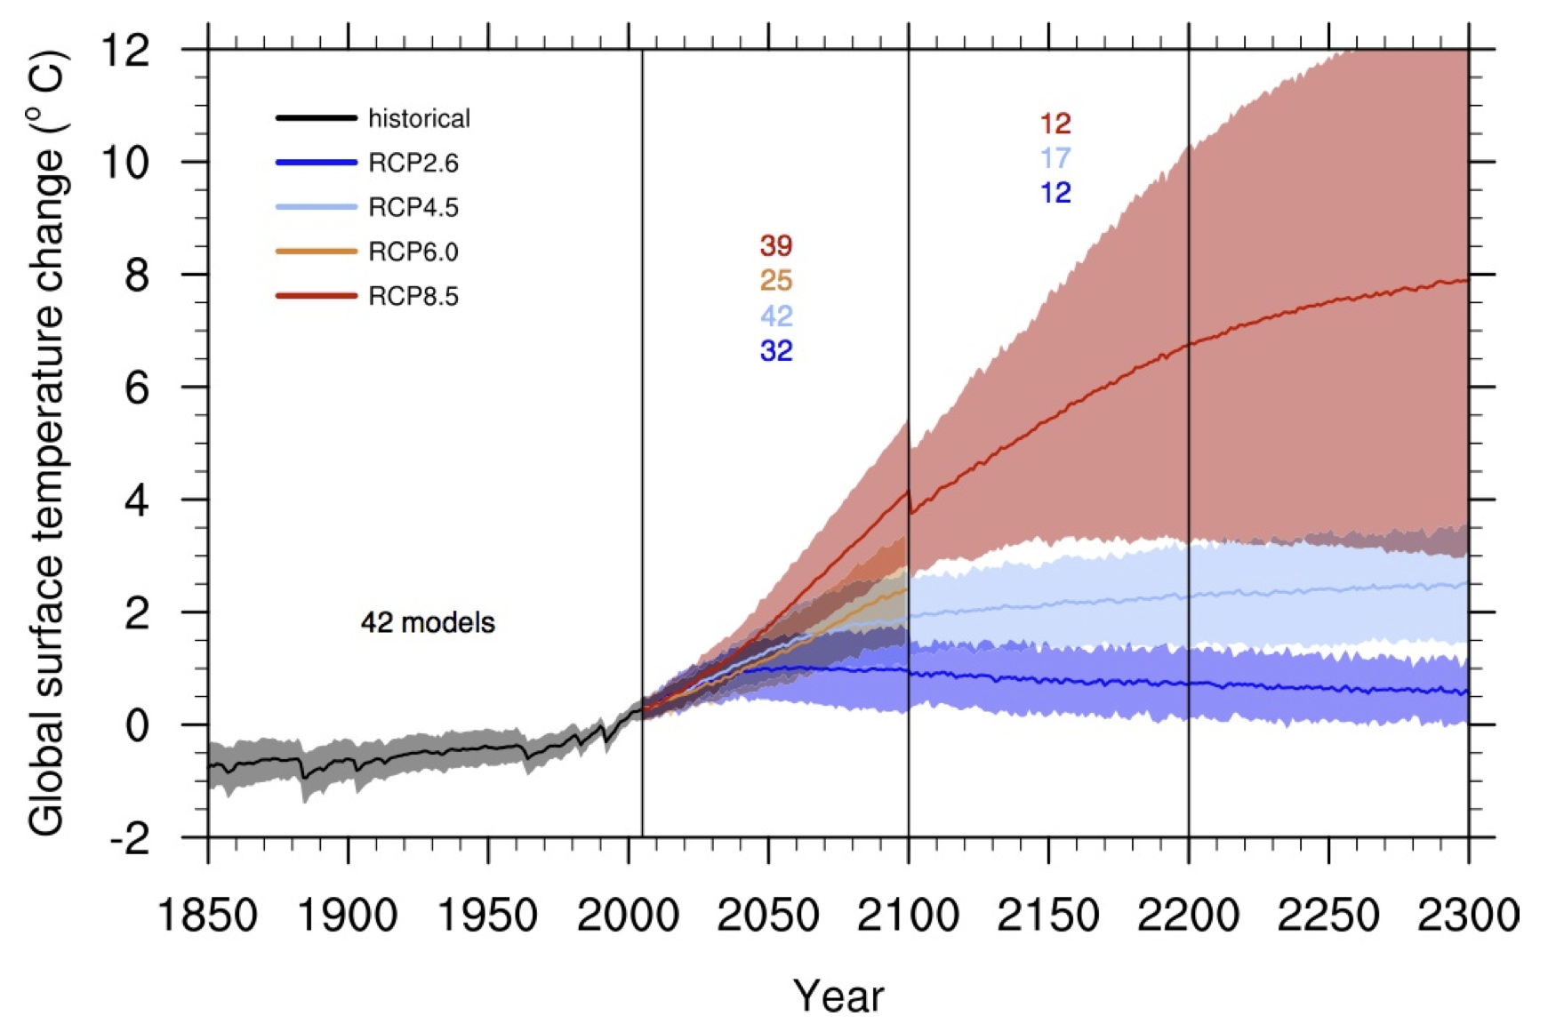
We will become scientific Nostrodamii
We’re going to make scientific predictions
I.e. Possible future scenarios which may be true
“The garden of forking paths”
Book about alternative futures
Because we want to be responsible seers we will outline alternative futures
Just like the IPCC does with climate projections

Slide 6
Step 1 to become Nostradamus
To know what will happen in the future,
We must know the current state of the world;
Population sizes
Closed CMR
Population growth rate
This lecture

Slide 7


What will our population size be at $t+1$?
$$N_{t+1}=N_{t}+B−D+I−E$$
Population size next year
Number of births
Number of immigrants
Population in current year
Number of deaths
Number of emigrants

Slide 8
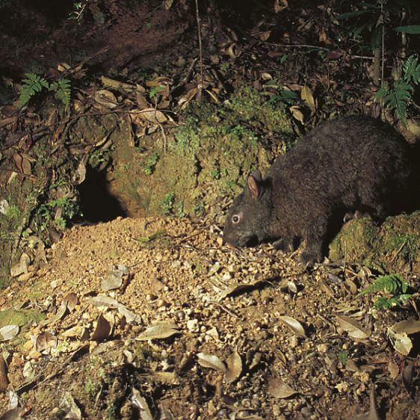
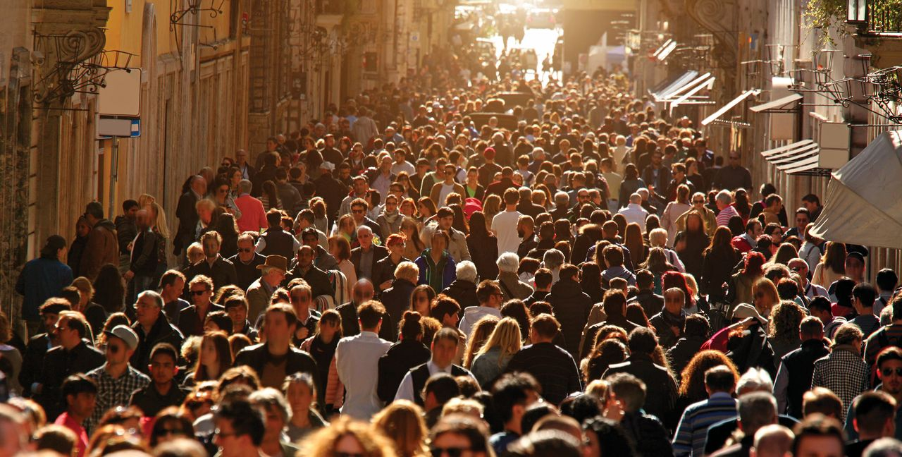

How does our species grow ($B$)?
Exponential growth
No distinct breeding season
Population increase continuously throughout year
Young added at any point in time
Geometric growth
Distinct breeding season
(Or non-overlapping generations)
Young added at specific points in time

Slide 9
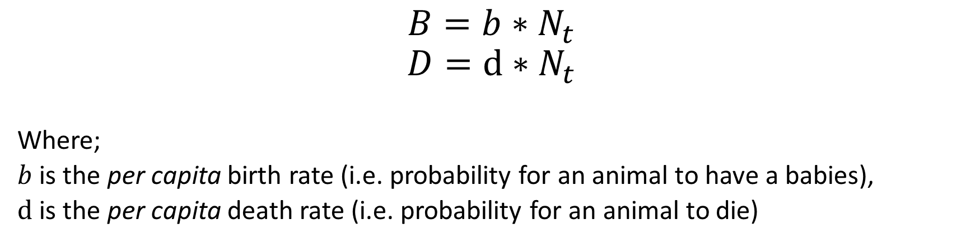


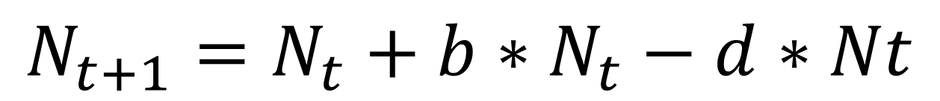

Improving $N_{t+1}= …$
$$N_{t+1}=N_{t}+B−D$$
$$N_{t+1}=N_{t}+\left(b−d\right)∗N_{t}$$
$$N_{t+1}=N_{t}+b∗N_{t}−d∗Nt$$
$$B=b∗N_{t}$$
$$D=d∗N_{t}$$
Where;
$b$ is the per capita birth rate (i.e. probability for an animal to have a babies),
$d$ is the per capita death rate (i.e. probability for an animal to die)

Slide 10
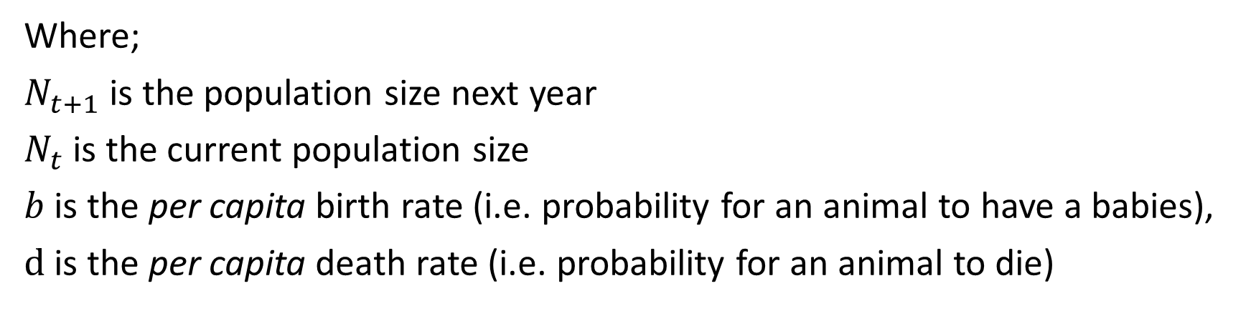



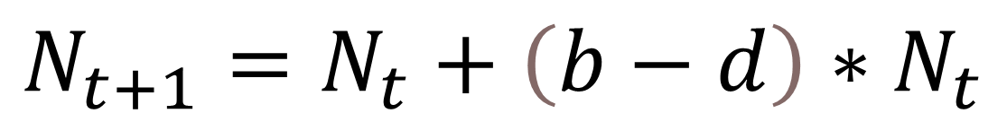
DIY $N_{t+1}$
$$N_{t+1}=N_{t}+\left(b−d\right)∗N_{t}$$
What is our population size next year, if;
$$N_{t}=120$$
$$b=0.23$$
$$d=0.18$$
$$N_{t+1}=126$$
Where;
$N_{t+1}$ is the population size next year
$N_{t}$ is the current population size
$b$ is the per capita birth rate (i.e. probability for an animal to have a babies),
$d$ is the per capita death rate (i.e. probability for an animal to die)

Slide 11
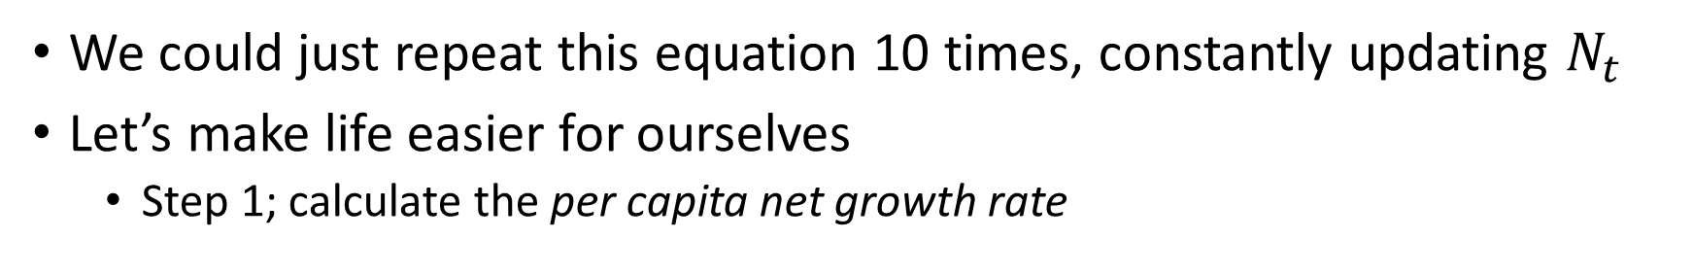

What about the population size in 10 years?
$$N_{t+1}=N_{t}+\left(b−d\right)∗N_{t}$$
We could just repeat this equation 10 times, constantly updating $N_{t}$
Let’s make life easier for ourselves
Step 1; calculate the per capita net growth rate

Slide 12


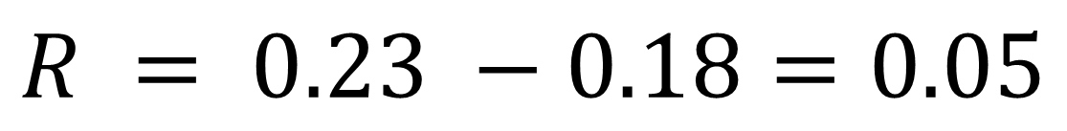
Per capita net growth rate
$$R = b −d$$
$$R = 0.23 −0.18=0.05$$
I.e. the population grows by 5% each year
Where;
$R$ is the per capita net growth rate
$b$ is the per capita birth rate (0.23),
$d$ is the per capita death rate (0.18)

Slide 13

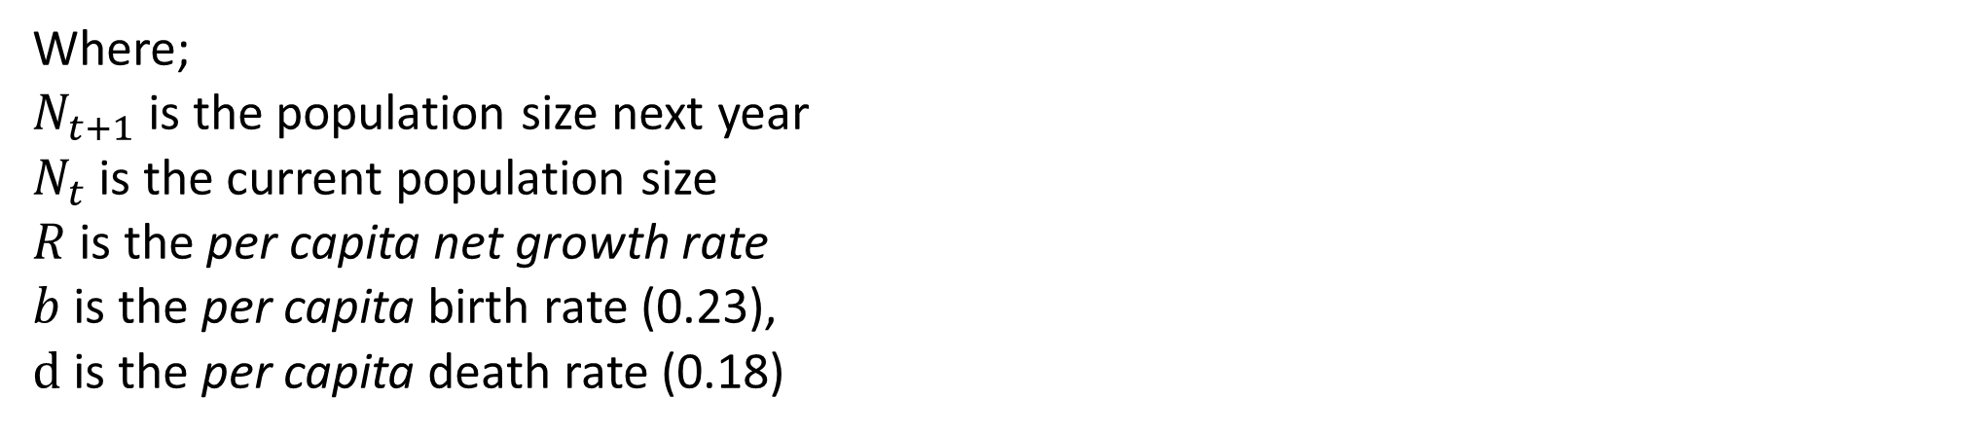
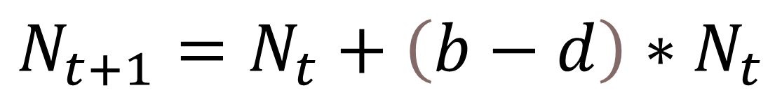
Updating the geometric growth rate
$$N_{t+1}=N_{t}+\left(b−d\right)∗N_{t}$$
$$N_{t+1}=N_{t}+R ∗ N_{t}$$
Where;
$N_{t+1}$ is the population size next year
$N_{t}$ is the current population size
$R$ is the per capita net growth rate
$b$ is the per capita birth rate (0.23),
$d$ is the per capita death rate (0.18)

Slide 14

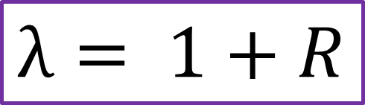
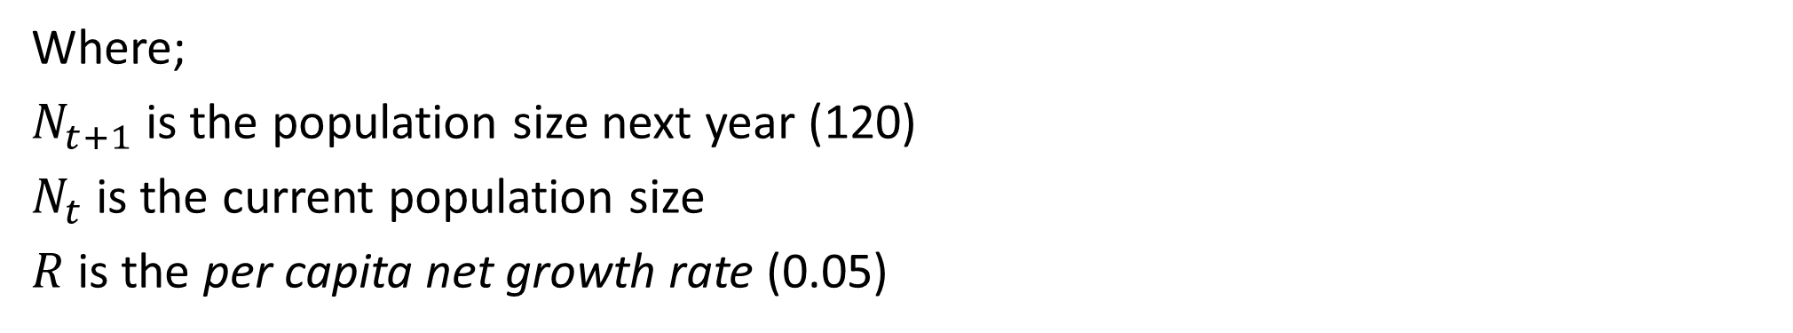



Geometric growth rate
$$N_{t+1}=N_{t}+R ∗ N_{t}$$
$$N_{t+1}=120+0.05 ∗120=126$$
$$N_{t+1}=\left(1+R\right)∗N_{t}$$
$$N_{t+1}=\left(1+0.05\right)∗120=126$$
The geometric population growth rate
$$λ= 1+R$$
Where;
$N_{t+1}$ is the population size next year (120)
$N_{t}$ is the current population size
$R$ is the per capita net growth rate (0.05)

Slide 15
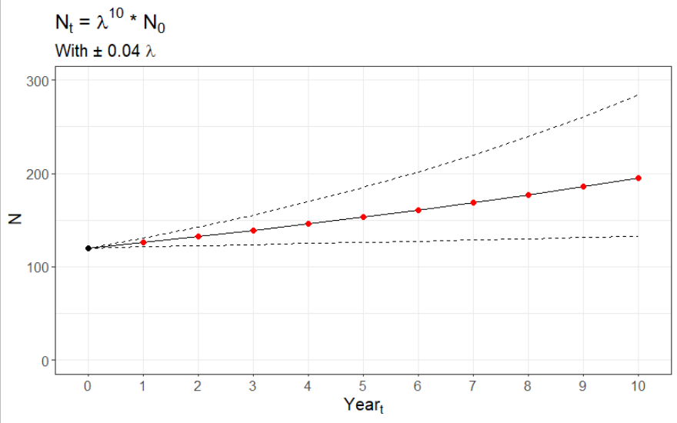
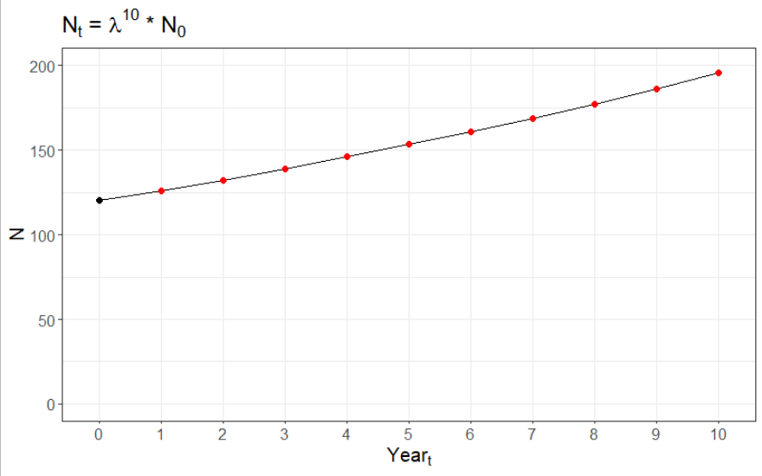






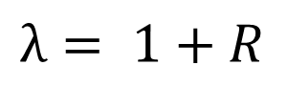


What about the population size in 10 years?
$$N_{t+1}=N_{t}+B−D$$
$$N_{t+1}=N_{t}+b∗N_{t}−d∗Nt$$
Require you redo calculation for every year
$$N_{t}=λ^{t}∗N_{0}$$
$$N_{t+1}=N_{t}+\left(b−d\right)∗N_{t}$$
$$R = b − a$$
$$N_{10}=λ^{10}∗N_{0}={1.05}^{10}∗120=195.5$$
$$N_{t+1}=N_{t}+R ∗ N_{t}$$
$$λ= 1+R$$
$$N_{t+1}=(1+R) ∗ N_{t}$$

Slide 16
tl;dr
Geometric growth allows us to predict population sizes into the future
Using our current understanding of the population
To do so we need 3 pieces of information;
Most recent population size,
Birth rate,
Death rate
But geometric growth models have a strict assumption
No age or stage structures (all individuals can breed)
When we do not have all this information (e.g. as with Amami rabbits), we can instead use Matrix Models

